Slide 1

Education and Training of Laboratory Animal Veterinarians Around the World
IACLAM Day
1June2025
Athens Greece
Michele Bailey, DVM, MRCVS, DACLAM
Gary Borkowski, DVM, MS, DACLAM

Slide 2
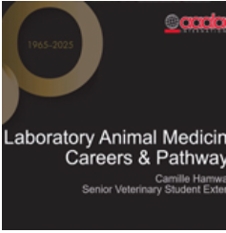
Laboratory Animal Veterinarians (LAV)
LAVs:
  Play a crucial role in ensuring
    the ethical and humane treatment of laboratory animals
    high quality research
  Vital to the success of scientific endeavors, bridging the gap between animal welfare and the demands of research

Slide 3

LAVs around the Globe
Biomedical research and the pharmaceutical industry are global
LAVs are vital to the success of these endeavors
However the education and training of LAVs varies around the world
Although approaches can be diverse we must aim to produce highly
skilled veterinarians dedicated to scientific integrity

Slide 4
Laboratory Animal Medicine (LAM)
Specialty Training
LAM has been a veterinary specialty for over 65 years
The International Association of LAM (IACLAM) was established in 2005
5 colleges, and one associate college have come together to form IACLAM
  American College of LAM (ACLAM) - founding
  European College of LAM (ECLAM) – founding
  Japanese College of LAM (JCLAM) – founding
  Korean College of LAM (KCLAM) –founding
  Indian College of LAM (ICLAM)
  Philippines College of LAM (PCLAM) - associate

Slide 5







Slide 6
IACLAM
Provides a common platform at the global level for communication by, and representation of, these Colleges and their Diplomates.
  Diplomate is a title that refers to a veterinarian who is certified in a veterinary specialty area, in this case in the field of laboratory animal medicine
Assists achieving the shared objectives of all the Colleges to promote the welfare and responsible use of laboratory animals through their certification of veterinary specialists, education, the dissemination of information relevant to the field, and serving as research partners.
Improves animal welfare policies and standards worldwide
Uses resource sharing to enable development of the LAM specially in countries or regions in which it does not yet formally exist

Slide 7
IACLAM
Supports high quality education, training and continuing professional development of LAVs around the world
Long term goal is to harmonize global expectations for the training and education of LAV, and in particular, those that are seeking to become specialized in the field.
Because it is SO important to ensure animal welfare and quality research, IACLAM
  encourages rigorous training of veterinarians in the field of LAM, and
  encourages the development of colleges of specialists in LAM in regions or countries where such colleges do not exist

Slide 8
IACLAM
Aids in developing workable frameworks for certifying veterinarians in the specialty of LAM based on the collective experience of established Colleges.
Associate membership provides recognition of efforts to achieve identified milestones.
  IACLAM allows representatives of Colleges that aspire to become members to participate in meetings as non-voting observers.
  As a developing college works towards meeting the criteria for full membership in IACLAM, IACLAM will welcome them to the organization as an associate member college.
  At present there is one associate member college
    Philippine College of Laboratory Animal Medicine
    Work in progress for another associate member college (stay tuned…)

Slide 9
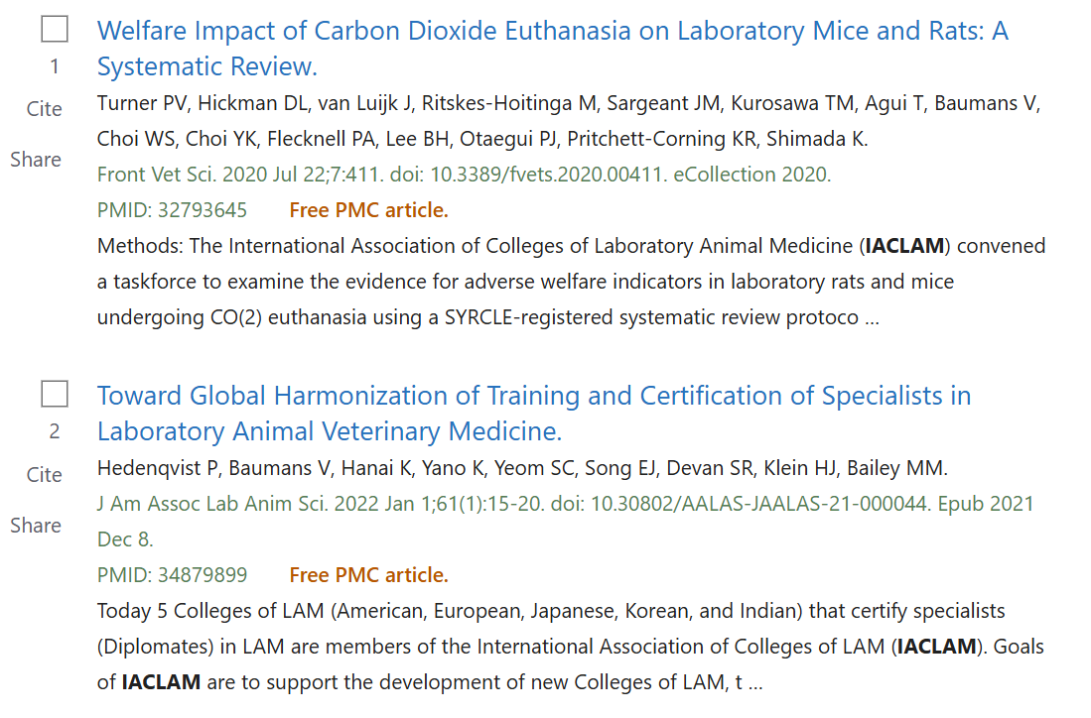
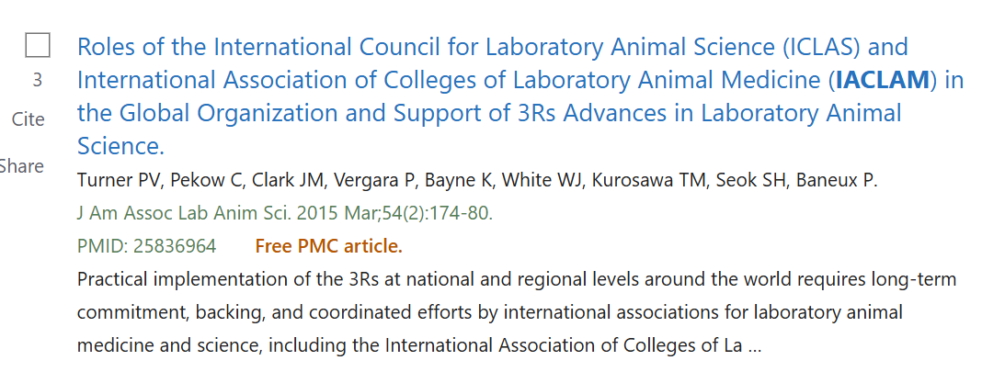
IACLAM
Peer reviewed literature

Slide 10
IACLAM Education Standing Committee
GOAL – enhance research animal welfare by supporting outreach, education and training of highly qualified laboratory veterinarians
Promote harmonization (not standardization) of
  Knowledge and skills required for a newly boarded LAV
  Required research
  Publication requirements
  Residency requirements
  Alternative training to residency requirements
  Examination methodology

Slide 11
Difference between HARMONIZATION and STANDARDIZATION
Standardization aims to eliminate any variation; required
Harmonization aims to reduce the variation between Colleges; relies on performance standards
IACLAM’s goal is NOT to standardize training and certification, but aims to harmonize training and veterinary skills and knowledge with the goal of global recognition of LAM Diplomates
IACLAM wants to harmonize recommendations as a means of supporting optimal and consistent welfare of research animals and high quality research globally

Slide 12
Knowledge and Skills
The LAM specialty is very broad and encompasses specific knowledge of several animal species that are not always part of the veterinary education curriculum
  e.g., NHPs, rodents, zebrafish
The European, American, Japanese, Indian and Korean Colleges of LAM have harmonized the minimal knowledge and skills required of a newly boarded Diplomate of LAM
  The knowledge/skills required are grouped into those that are learned during basic veterinary training, those learned after veterinary school (for example during a residency program), and those that would be learned after certification (e.g., on–the-job training)

Slide 13
Knowledge and Skills
Regional-specific differences exist:
  Whether some knowledge is acquired during veterinary school or residency training
    Attributed to the different veterinary training curricula in various countries
  Laws, regulations and guidelines specific to a country or region must be learned; knowledge of international laws can be acquired after certification

Slide 14
Knowledge and Skills
The most important species may differ by country/regions, and thus emphasis may vary
  Importance is based on the number of animals of each species used in research in the particular region
    All member colleges agree that mice, rats and rabbits are of primary importance, while India also include guinea pigs as a primary species
    The American, European and Japanese colleges include macaques and dogs as primary species
    The European college views zebrafish as a primary species
    The American and European college view pigs as of primary importance, India of tertiary importance, and all other colleges view pigs of secondary importance
    Japan gives special importance to medaka (Japanese killifish), carp and Japanese quail

Slide 15
Knowledge and Skills Summary
All 5 member Colleges have agreed on the required skills and knowledge needed for a newly boarded Diplomate, with minor differences in regional emphasis

Slide 16
Alternative to Residency Training in LAM
Residency – specific training program for specializing in LAM
Alternative/experience route – non-standard training that allows practicing LAVs to work toward specialty certification
Flexibility in training routes increases the number of specialists

Slide 17
Alternative to Residency Training in LAM
Similarities between Colleges
  Same requirements for skills and knowledge, regardless of training route
  PhD training, using research animals, counts as part of the training
  A research project culminating in publication of a scientific paper, in a peer-reviewed journal, is required for eligibility to take the certification exam
  All candidates must pass the same certification exam, regardless of their training route

Slide 18
Harmonization of Residency training programs
At present this is not possible, as only 3 of 5 member Colleges have structured training programs, under the supervision of a Diplomate(s)
As discussed, all colleges offer alternative routes of training

Slide 19
Harmonization of Certification Exam
This is a work-in-progress
There are currently differences between the Colleges of how exam questions are developed, and how passing scores are determined

Slide 20
Summary
IACLAM endeavors to enhance research animal welfare by supporting outreach, education and training of highly qualified laboratory veterinarians
To accomplish this, IACLAM promotes harmonization (not standardization) of
  Knowledge and skills required for a newly boarded LAV
  Required research
  Publication requirements
  Residency requirements
  Alternative training to residency requirements
  Examination methodology

Slide 21
Summary
  Thus far the following have been harmonized amongst the five member Colleges
  The knowledge and skills required for a newly boarded LAM specialist
  Minimum research requirements
  Minimum publication requirements
  The harmonization of training program requirements and certification exam methodology are on-going projects

